Slide 1
Day 5, Session 1:
Data: Management, Infrastructure, and Datasets to Know

Slide 2
All scientific problems require data, but machine-learning problems are famous for requiring a lot of data. So, how do we manage that?

Slide 3
First, with our own data we need to implement a data management plan.

Slide 4
In data management, we strive to be FAIR.
https://en.wikipedia.org/wiki/FAIR_data
The FAIR Guiding Principles for scientific data management and stewardship.
https://doi.org/10.1038/sdata.2016.18

Slide 5
F1. (Meta)data are assigned a globally unique and persistent identifier.
F2. Data are described with rich metadata.
F3. Metadata clearly & explicitly include the identifier of the data they describe.
F4. (Meta)data are registered or indexed in a searchable resource.
https://en.wikipedia.org/wiki/FAIR_data
The FAIR Guiding Principles for scientific data management and stewardship.
Wilkinson, M., Dumontier, M., Aalbersberg, I. et al.
Nature Scientific Data 3, 160018 (2016).
https://doi.org/10.1038/sdata.2016.18 v

Slide 6
A1. (Meta)data are retrievable by their identifier using a standardised communications protocol.
A1.1 The protocol is open, free, and universally implementable.
A1.2 The protocol allows for an authentication and authorisation procedure, where necessary.
A2. Metadata are accessible, even when the data are no longer available.
https://en.wikipedia.org/wiki/FAIR_data
The FAIR Guiding Principles for scientific data management and stewardship.
Wilkinson, M., Dumontier, M., Aalbersberg, I. et al.
Nature Scientific Data 3, 160018 (2016).
https://doi.org/10.1038/sdata.2016.18 v

Slide 7
I1. (Meta)data use a formal, accessible, shared, and broadly applicable language for knowledge representation.
I2. (Meta)data use vocabularies that follow FAIR principles.
I3. (Meta)data include qualified references to other (meta)data.
https://en.wikipedia.org/wiki/FAIR_data
The FAIR Guiding Principles for scientific data management and stewardship.
Wilkinson, M., Dumontier, M., Aalbersberg, I. et al.
Nature Scientific Data 3, 160018 (2016).
https://doi.org/10.1038/sdata.2016.18 v

Slide 8
R1. Meta(data) are richly described with a plurality of accurate and relevant attributes.
R1.1. (Meta)data are released with a clear and accessible data usage license.
R1.2. (Meta)data are associated with detailed provenance.
R1.3. (Meta)data meet domain-relevant community standards.
https://en.wikipedia.org/wiki/FAIR_data
The FAIR Guiding Principles for scientific data management and stewardship.
Wilkinson, M., Dumontier, M., Aalbersberg, I. et al.
Nature Scientific Data 3, 160018 (2016).
https://doi.org/10.1038/sdata.2016.18 v

Slide 9

T R U E
Transparent
Reproducible
Usable by Others
Extensible
Towards molecular simulations that are transparent,
reproducible, usable by others, and extensible (TRUE)
M. W. Thompson, J. B. Gilmer, R. A. Matsumoto, C. D. Quach,
P. Shamaprasad, A. H. Yang, C. R. Iacovella, C. McCabe & P. T. Cummings
Molecular Physics (2020)
https://doi.org/10.1080/00268976.2020.1742938

Slide 10
Implementing FAIR principles in our data management

Slide 11
Effort Spent on Data Management
Conception
Creation
Finalization
Publication
Archival
Maintenance
Lifespan of a Dataset

Slide 12
Good enough practices in scientific computing. G. Wilson, et al. , PLoS Comput Biol 13(6): e1005510. (2017) https://doi.org/10.1371/journal.pcbi.1005510
Best Practices for Scientific Computing. G. Wilson, et al., PLoS Biol 12(1): e1001745. (2014) https://www.doi.org/10.1371/journal.pbio.1001745
Automated capture of experiment context for easier reproducibility in computational research. Andrew Davison, Computing in Science & Engineering 14.4 (2012): 48-56. https://www.doi.org/10.1109/MCSE.2012.41
Initial Steps towards Reproducible Research. Karl Broman. https://kbroman.org/steps2rr/ https://github.com/kbroman/steps2rr
(How much has changed)
Database management in scientific computing—I. General description. Carlos Felippa, Computers & Structures. 10. 53-61. (1979). https://doi.org/10.1016/0045-7949(79)90073-7.

Slide 13
Write an overview of the project scope and goals.
Research the data policies of relevant funding organizations/publications and incorporate their policies into your plan.
Create a shared to-do list for the project.
Decide on a communication strategy.
Discuss data sharing and licensing.
Make an initial, revisable data plan.
Conception
Conception
Creation
Finalization
Publication
Archival
Maintenance
Lifespan of a Dataset

Slide 14
Data
Save and back up raw data.
Use unique and searchable identifiers.
Create the analysis-friendly data you wish to see in the world.
Record static data (metadata and input parameters) for each computation or simulation. This includes random seeds.
Record all steps used to generate, process, and analyze data.
Creation
Conception
Creation
Finalization
Publication
Archival
Maintenance
Lifespan of a Dataset

Slide 15
Programs/Scripts
Provide comments/documentation wherever possible. Keep formatting and code style consistent.
Give files, functions, and variables meaningful, consistent, and distinctive names.
Employ modular coding: decompose programs into functions, eliminate all duplication.
Always search for well-maintained software libraries that do what you need. Test them before replying on them. Make dependencies and requirements explicit.
Separate code from configuration: do not rely on (un)commenting to control a program’s behavior.
Pair-program when possible.
Use containers and environments when possible or switching between code versions.
Creation
Conception
Creation
Finalization
Publication
Archival
Maintenance
Lifespan of a Dataset

Slide 16
Organization
Organize files in a transparent, compact, and understandable manner, (e.g. employing folder names such as doc, src, bin)
Keep changes small and share frequently.
Use a version control system and back up everything possible.
Revisit your data management plan periodically and adjust as needed.
Creation
Conception
Creation
Finalization
Publication
Archival
Maintenance
Lifespan of a Dataset

Slide 17
Solicit data and documentation audits from colleagues and friends.
Provide a simple example or test data set.
Optimize program performance, if possible.
Revisit your data management plan periodically and adjust as needed.
Finalization
Conception
Creation
Finalization
Publication
Archival
Maintenance
Lifespan of a Dataset

Slide 18
Write manuscripts using tools with formatting, change tracking, reference management, and version control.
Report all data creation, processing, and analysis procedures with all details necessary for reproduction. Include test matrices and code versions.
Revisit journal/funding agency data management guidelines.
Publication
Conception
Creation
Finalization
Publication
Archival
Maintenance
Lifespan of a Dataset

Slide 19
Submit code and data to a reputable DOI-issuing repository.
Make the license explicit.
Archival
Conception
Creation
Finalization
Publication
Archival
Maintenance
Lifespan of a Dataset

Slide 20
Provide a static contact or update contact periodically for questions and inquiries.
If dataset becomes deprecated, update it to note such.
Maintenance
Conception
Creation
Finalization
Publication
Archival
Maintenance
Lifespan of a Dataset

Slide 21
Open* datasets and databases in molecular sciences worth knowing
Where do we archive and maintain our data?
*Some of these databases require academic licenses

Slide 22
Let’s first distinguish datasets from databases and data platforms
A data platform is the interface by which you access a database, and can include different formatting requirements or API options.
A database is a collection of datasets with a set of organization rules and contribution guidelines.
A dataset is a collection of data that somehow go together.

Slide 23
(Primarily) Experimental Data Platforms

Slide 24

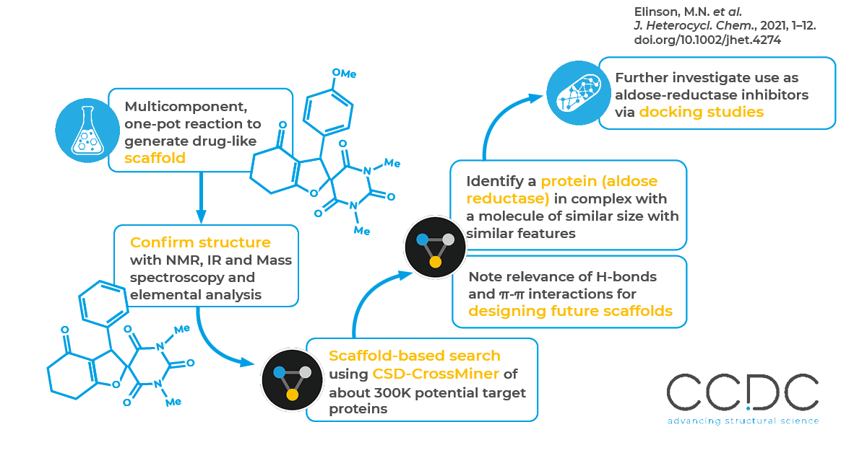
The Cambridge Structure Database (CSD) started in 1965 out of the Cambridge Crystallographic Data Centre (CCDC) to share X-ray crystallography data.

Slide 25
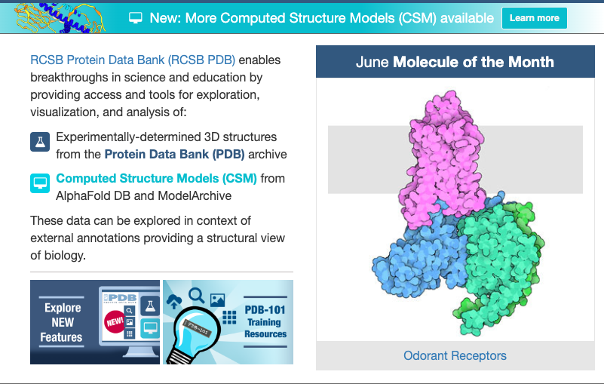
The Protein Data Bank (PDB) started in 1971 to share 3D structural data of large biological molecules.

Slide 26

Enamine publishes high-quality datasets aimed at small-molecule drug delivery.

Slide 27


The Crystallographic Open Database (COD), Inorganic Crystal Structure Database (ICSD), and others also provide high-quality crystallographic data.
More resources: https://chem.libretexts.org/Courses/Intercollegiate_Courses/Cheminformatics/03%3A_Database_Resources_in_Cheminformatics/3.03%3A_Public_Chemical_Databases

Slide 28
(Primarily) Computational Data Platforms

Slide 29
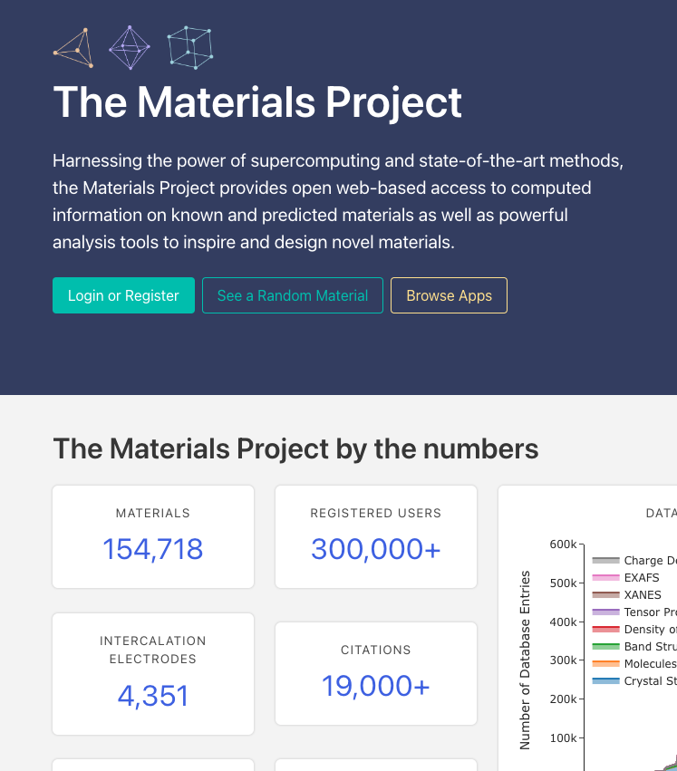
The Materials Project is an open-access database of materials properties start in 2011 to improve access to computed materials properties.

Slide 30
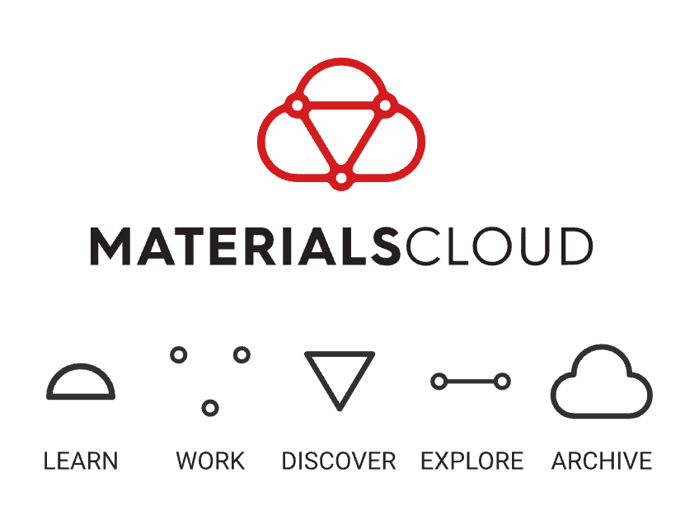
Materials Cloud is a peer-reviewed, ontology-free platform for sharing curated datasets and visualizations.

Slide 31

QC Archive is a source to compile, aggregate, query, and share quantum chemistry data.

Slide 32




NIST-Jarvis, NIST-ThermoML, AFLOW, OQMD, NOMAD, and others also provide high-quality computed data.

Slide 33
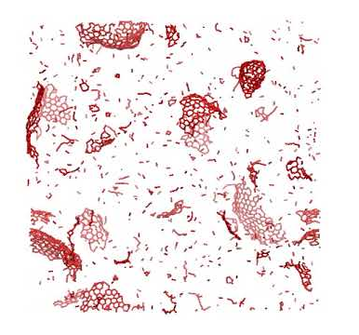
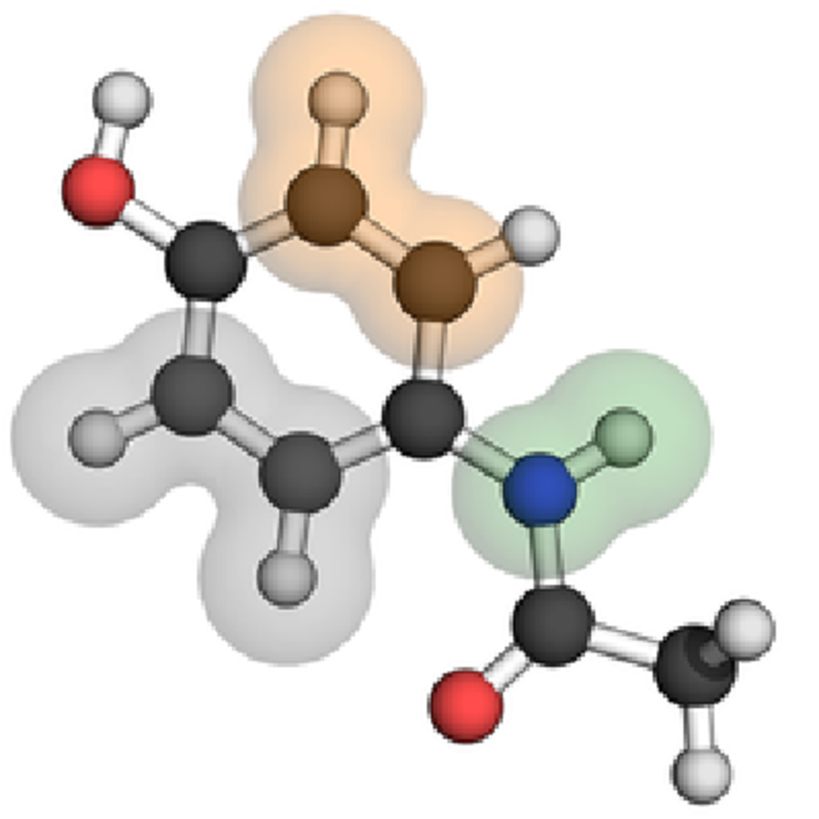
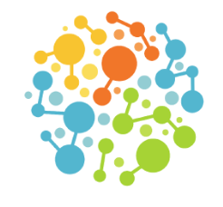
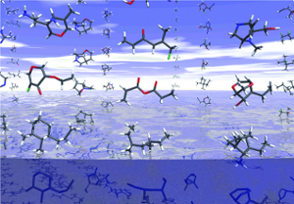
GDB13, QM7-9, ANI-1, and SPICE are landmark datasets comprised of computed quantities.
GDB-13: the largest publicly available small molecule dataset
QM7-9: A subset of GDB-13 of small molecules and PBE0 energetics
ANI-1: DFT-based energetics for off-equilibrium conformations of organic molecules
SPICE: QM data for small molecules and their interactions with proteins

